Slide 1
Updating your Status
How Facebook Talk Informs Us About Current Word Use

Slide 2
the Facebook
600 million users
Started at Harvard
2004 as a company
2005 bought facebook.com domain

Slide 3
the Facebook
3rd largest web company
After google.com and amazon.com
In March 2010, had more hits than google.com

Slide 4
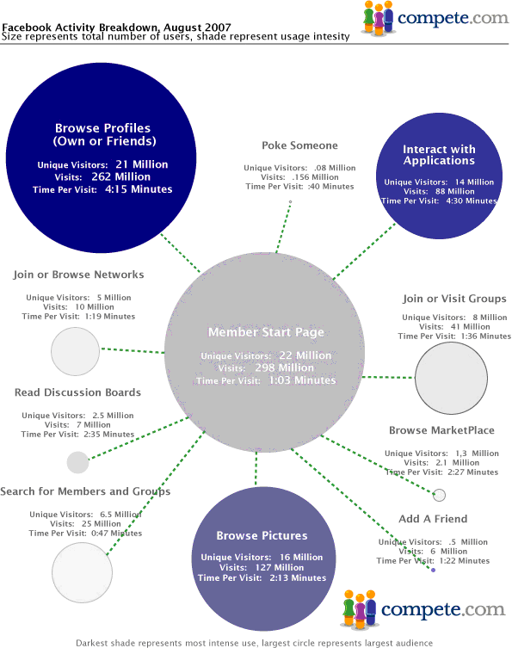
the Facebook

Slide 5
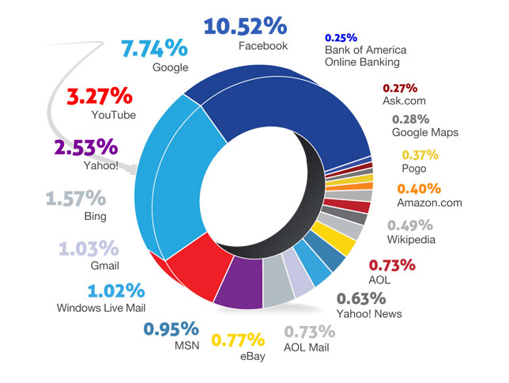

Slide 6

the Facebook
Word Use
Facebooking, Facebook – 2008
Unfriend – 2009
The Social Network - 2010

Slide 7
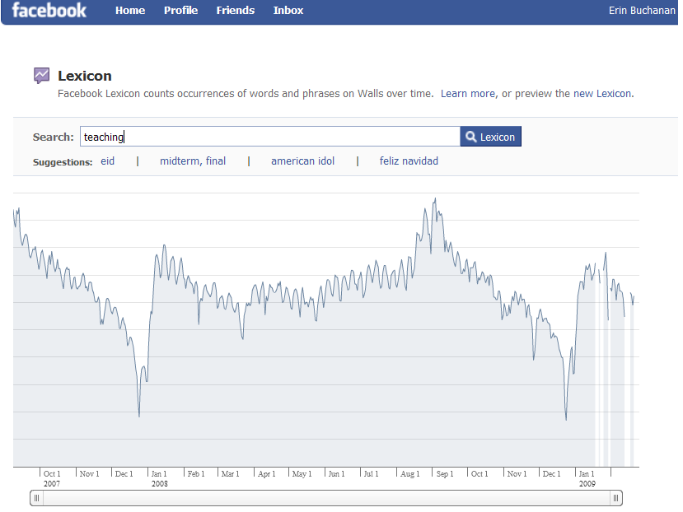

Slide 8
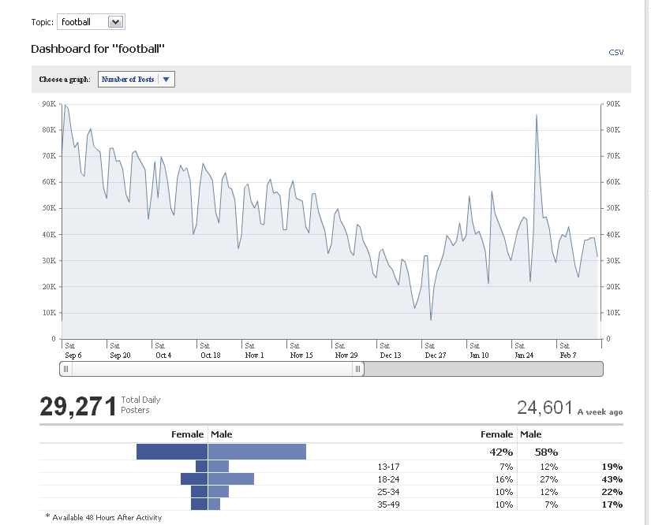

Slide 9
the Facebook
The only “web” program that has more users?
Social connectedness

Slide 10
Psycholinguistics
Psycholinguistics is a field of psychology that studies all the facets of language and how the interacts with the individual.
Dr. B studies word frequency and relationships between words – as well how our ability to remember that difference.

Slide 11
Previous Research
Frequency
Simple word counts – how often words appear in written text.
HAL – Hyperspace Analogue to Language (Burgess & Lund, 1997)
Brown Corpus (Kucera & Francis, 1967)
Google ngrams (Google.com, 2011)
Many more….

Slide 12
Previous Research
Semantics versus Association
Semantics = word meaning, the dictionary definition of a word
Association = word use, how often words are used together in context
Often these are the same thing, but they interact with frequency.
What do you think of when I say BANK?

Slide 13
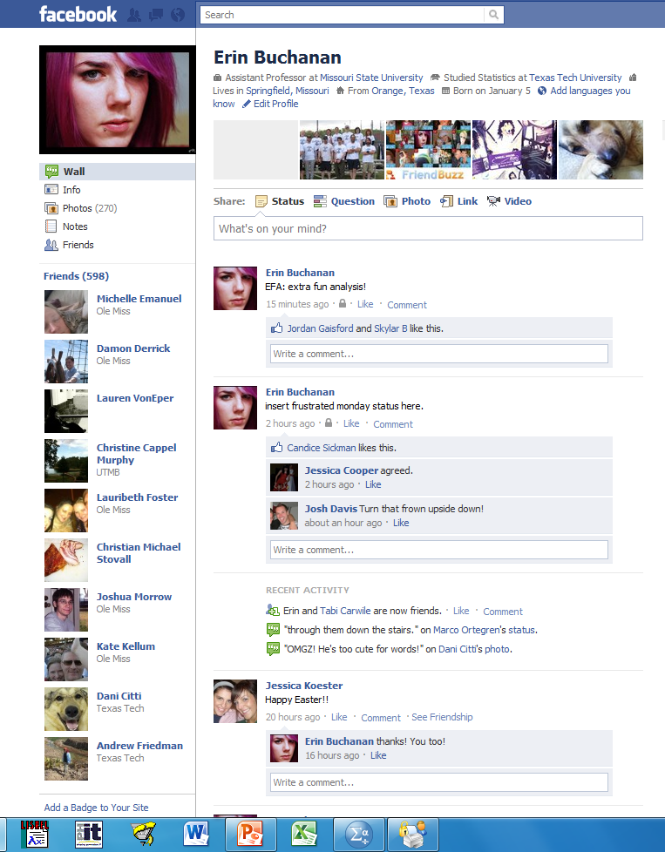

Slide 14
Current Study
Currently collecting Facebook walls
Number of Walls = 771
Donated for PSY 121 credit

Slide 15
Current Study
Dates of Status Updates
2004 to present
Over 2 Gigs of text information

Slide 16
Current Study
Each Facebook wall is reduced to posts and statuses
Then each timestamp is tagged with the status.
just loves being at work 3 hours after the store closes. Timestamp: Monday, March 29, 2010 at 1:31am
VEGAS BABY!!!!! Timestamp: Monday, February 1, 2010 at 12:47am
Flu shot: shot. Hannah Montana band-aid: stuck. Bam. Ready to roll. :) Timestamp: Wednesday, October 27, 2010 at 3:09pm
Pshhhhh. Timestamp: Saturday, July 11, 2009 at 12:01pm

Slide 17
Current Study
Word Use
Nearly 50,000-100,000 unique words were collected
Frequency was counted over all words
Time values to be added later for comparison
Only words with information in at least one frequency database are used here.
For example, lol omg wtf are all excluded because they were not in the databases for text word frequency.

Slide 18
Research Questions
How much of social word use overlaps with word use in texts?
Comparing to frequency norms from previous psycholinguistic research.
How do word frequencies change over time?
Will be able to compare to Google ngrams
How often do words appear together over time?
Will be able to compare to association norms

Slide 19
Most Common Words
http://www.sporcle.com/games/common_english_words.php

Slide 20
Most Common Words
 | Brown Corpus | HAL | Facebook
1 | a | the | I
2 | in | to | you
3 | he | of | to
4 | be | and | the
5 | I | a | a
6 | have | in | and
7 | one | is | is
8 | there | that | it
9 | who | you | in
10 | will | for | my

Slide 21
Results - Overlap
Facebook
HAL
49%
Facebook
Brown
40%

Slide 22
Results – Overlap
There appears to only be a 40-50% overlap between our social word use (hey!) and written word use (Hello.)
What is the rest?
Most common word uses are still similar
Pronouns
Verbs
Determinants
Prepositions

Slide 23
Results – Common Uses
There are several social implications from the top 100 words:
Happy Birthday = 11 and 15
Love = 26
Miss = 34
Hey = 39
Class = 51
Haha = 53

Slide 24
Results – So what?
What does this mean for everyday language?
Language is always changing and evolving – words are deleted and added to the dictionary yearly.
Over time languages tend to condense – we use less words to emphasize the same meaning.

Slide 25
Results – So what?
Social word use is an important phenomenon to understand.
Word use is more context (person to person) based and individualized.
For instance, you could post on someone’s wall I DID IT!! and you would know what they were talking about with no context as to what you “did”.
Written word use is more defined and user-separated.
When writing a newspaper article, the journalist has to write so that everyone will understand.

Slide 26
Results – So what?
Communication or facts?
What exactly is the purpose of all this speak?
Are we trying to communicate with people (without having to be in person)?
Or share facts and knowledge?
Obviously, social connection is key.

Slide 27
Results – What’s Next?
Put this information into a large database for other researchers to use (www.wordnorms.com).
Look at word frequency over time – are their reliable relationships that match probability relationships of word pairs?
For example, do cat and dog occur together as frequently as we associate them?
The probability is much lower than free association (50% versus 11%)
Other cool stuff?

